Slide 1

Mail-Order-Pharmacy
Presented by
Abhay Pratap Singh (2116786)
Ashok Patel (2116520)
Ankit Pandey (2116191)
Abhishek Chauhan (2118787)
Aaysha Sabreen M (2116065)

Slide 2
Project Overview

Slide 3
A leading Pharmaceutical Benefits Management (PBM) Organization wants to develop a Mail-Order Pharmacy module using Microservices.
PBM is a middle-man between an Insurance Company and its members. Because of its size, it can negotiate large customer contracts and negotiate with both pharmacies and pharmaceutical companies to get the best rates for the drugs.
Mail-order pharmacies operate through your health insurance plan and can be cheaper and more convenient than getting your medications from a local pharmacy. A “mail-order” prescription means that you don’t have to pick up your medication from a pharmacy; instead, it is delivered to your doorstep.
There will also be a Member Portal to be developed part of this scope that consumes these Microservices. The Portal allows its members to subscribe for drugs refill, allows to pay bills etc.

Slide 4
Application Functions
User needs to Login. Once successfully logged in, the user
can do the following operations:
View All Available Drugs.
Search Drugs by id and name.
Add/Remove Subscription and view All Subscriptions.
View The last Refill Status.
Add a Adhoc Refill.

Slide 5
Technologies used
Backend
Spring Boot
Database
H2 Database
Frontend
Angular

Slide 6
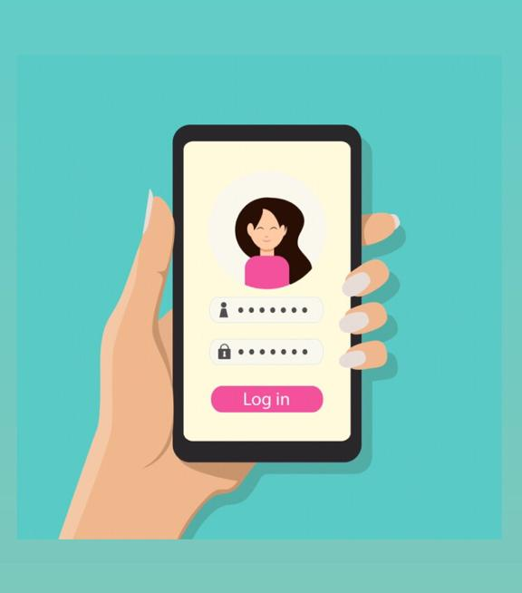
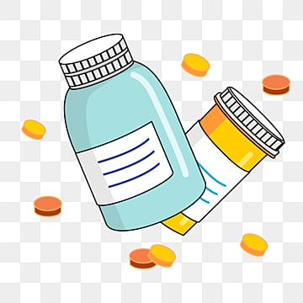


Microservices
Authorization Microservice
Drug Microservice
Subscription Microservice
Refill Microservice

Slide 7
Authorization Microservice – It is designed to authorize the application using JWT token.
Drug Microservice –Drugs Module is a Middleware Microservice that performs following operations:
Search Drugs by Name / ID
Get Dispatchable Stock of a Drug by Location
Subscription Microservice – Subscription Module is a Middleware Microservice that performs the following operations:
Subscribe/Un-subscribe for Mail-Order Pharmacy
Based on subscription, there will be a Mail-Order Delivery Module that will deliver the drugs to the members. Delivery is out of scope of the system. The Refill Details, Payment Status will be available in the Refill Module.

Slide 8
Refill Microservice – Refill Module is a Middleware Microservice that performs the following operations:
View Last Refill for the Subscriptions
Get Prescriptions that are Due For Refills
Take Adhoc Refill Order for a subscription
Member Portal– An Web Portal that allows a member to Login and allows to do following operations:
Login
Subscribe / Un-Subscribe for the Mail-Order
View the last refill status
View Prescriptions that are due for Refills
Take an Adhoc Refill Order
View Drugs

Slide 9
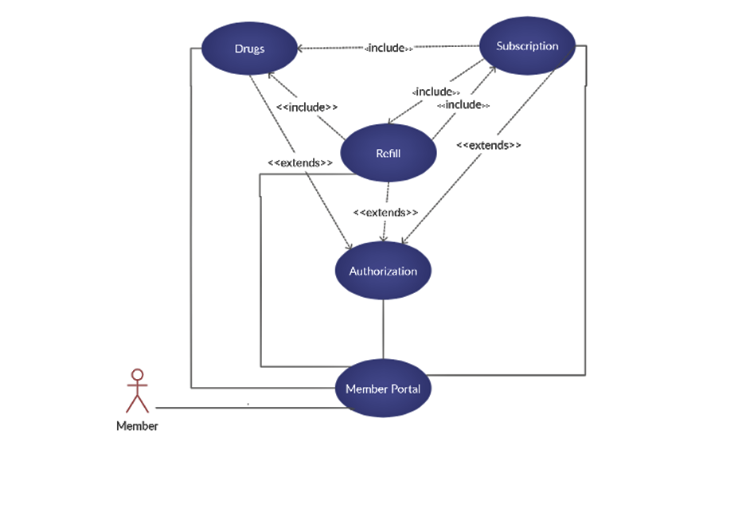
Use Case Diagram

Slide 10
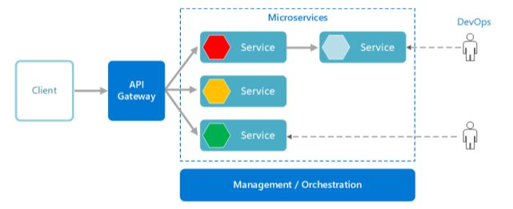
System Architecture Diagram

Slide 11
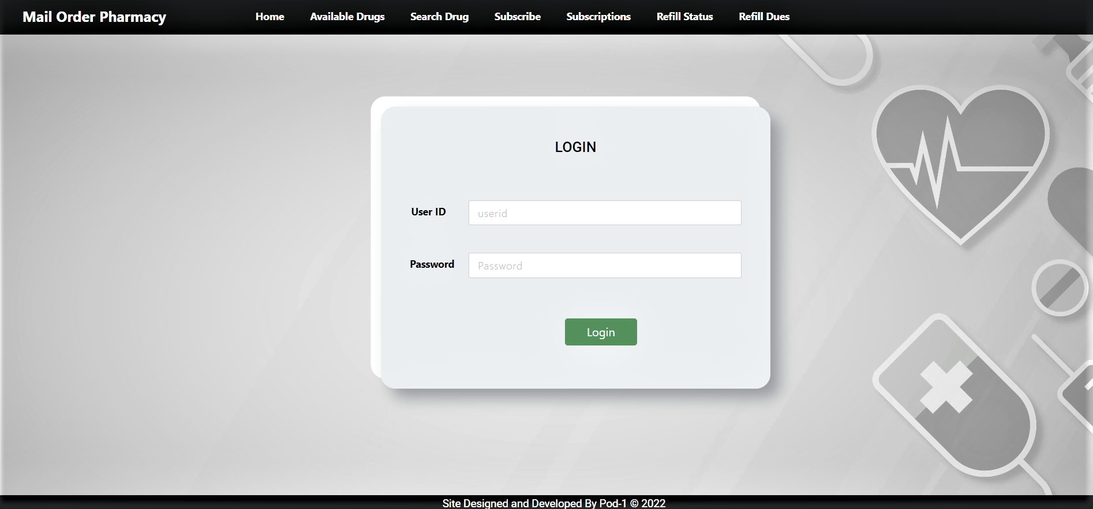
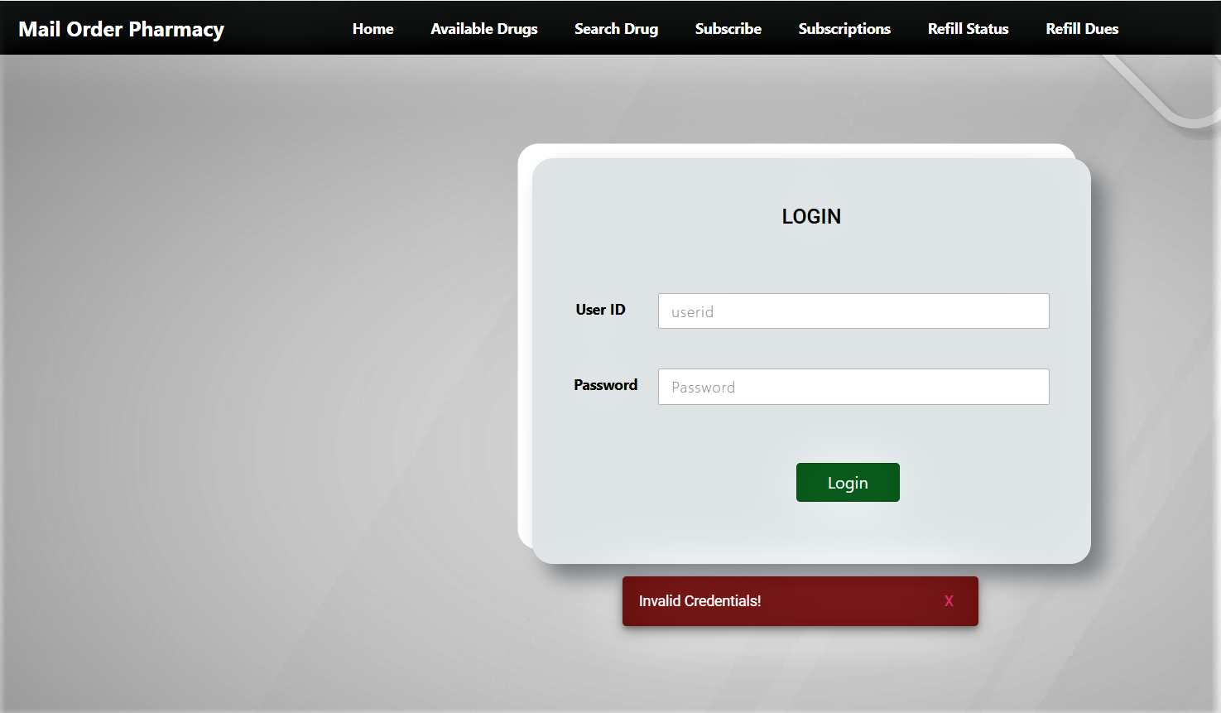
Login-UI

Slide 12
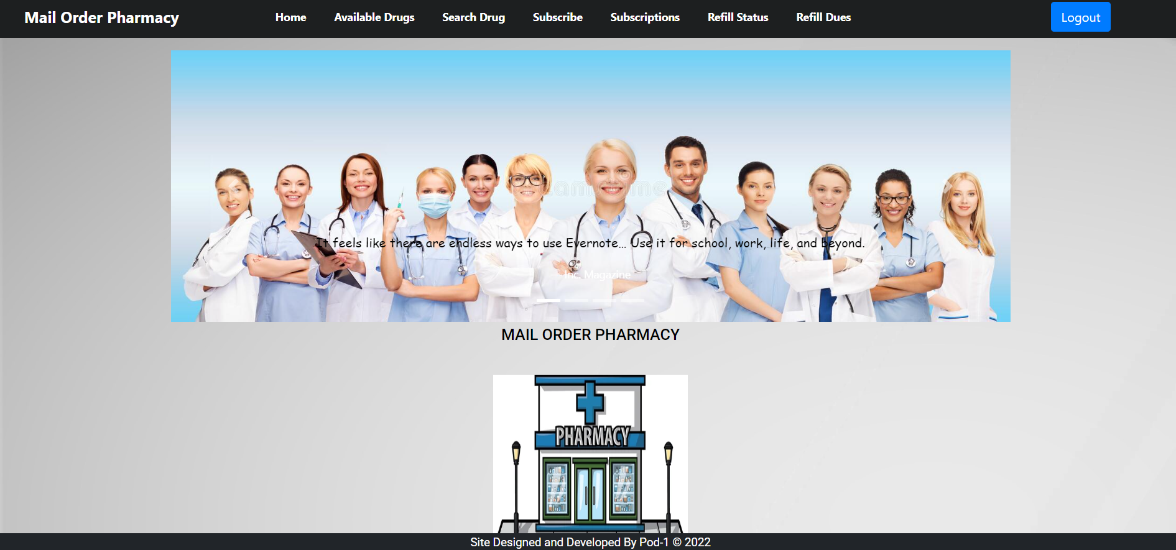
Home - UI

Slide 13
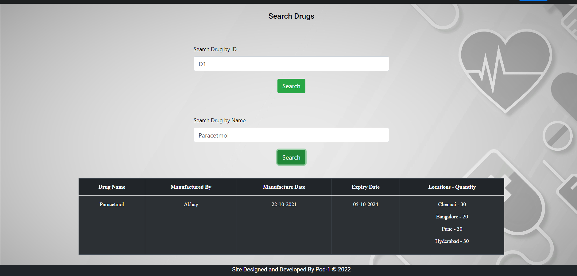
Search Drug - UI

Slide 14
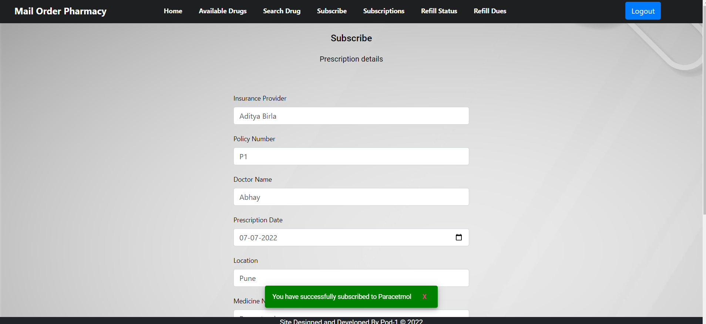
Subscription - UI

Slide 15
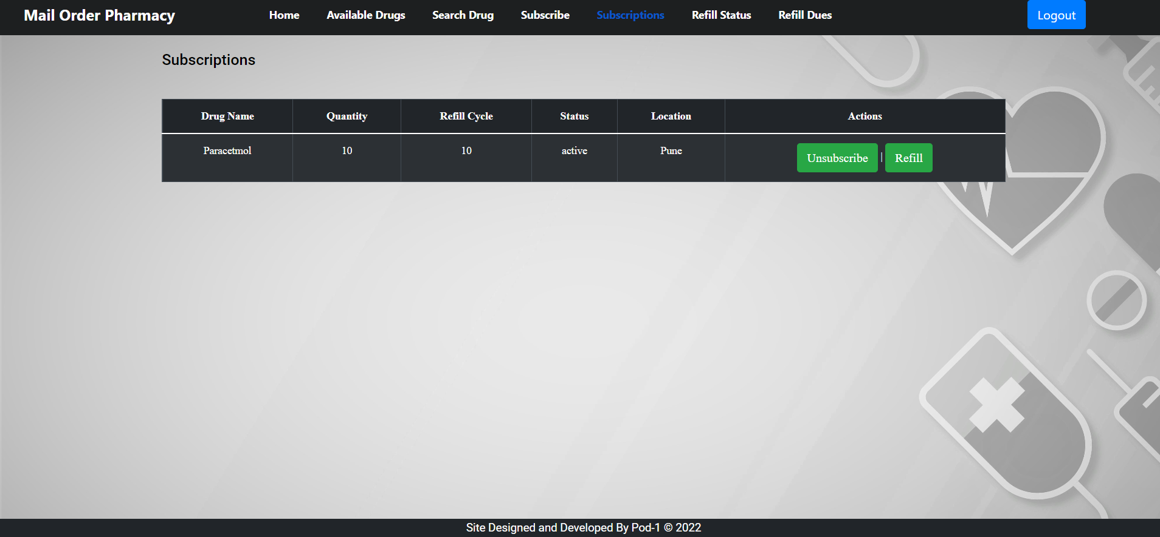
All Subscription - UI

Slide 16
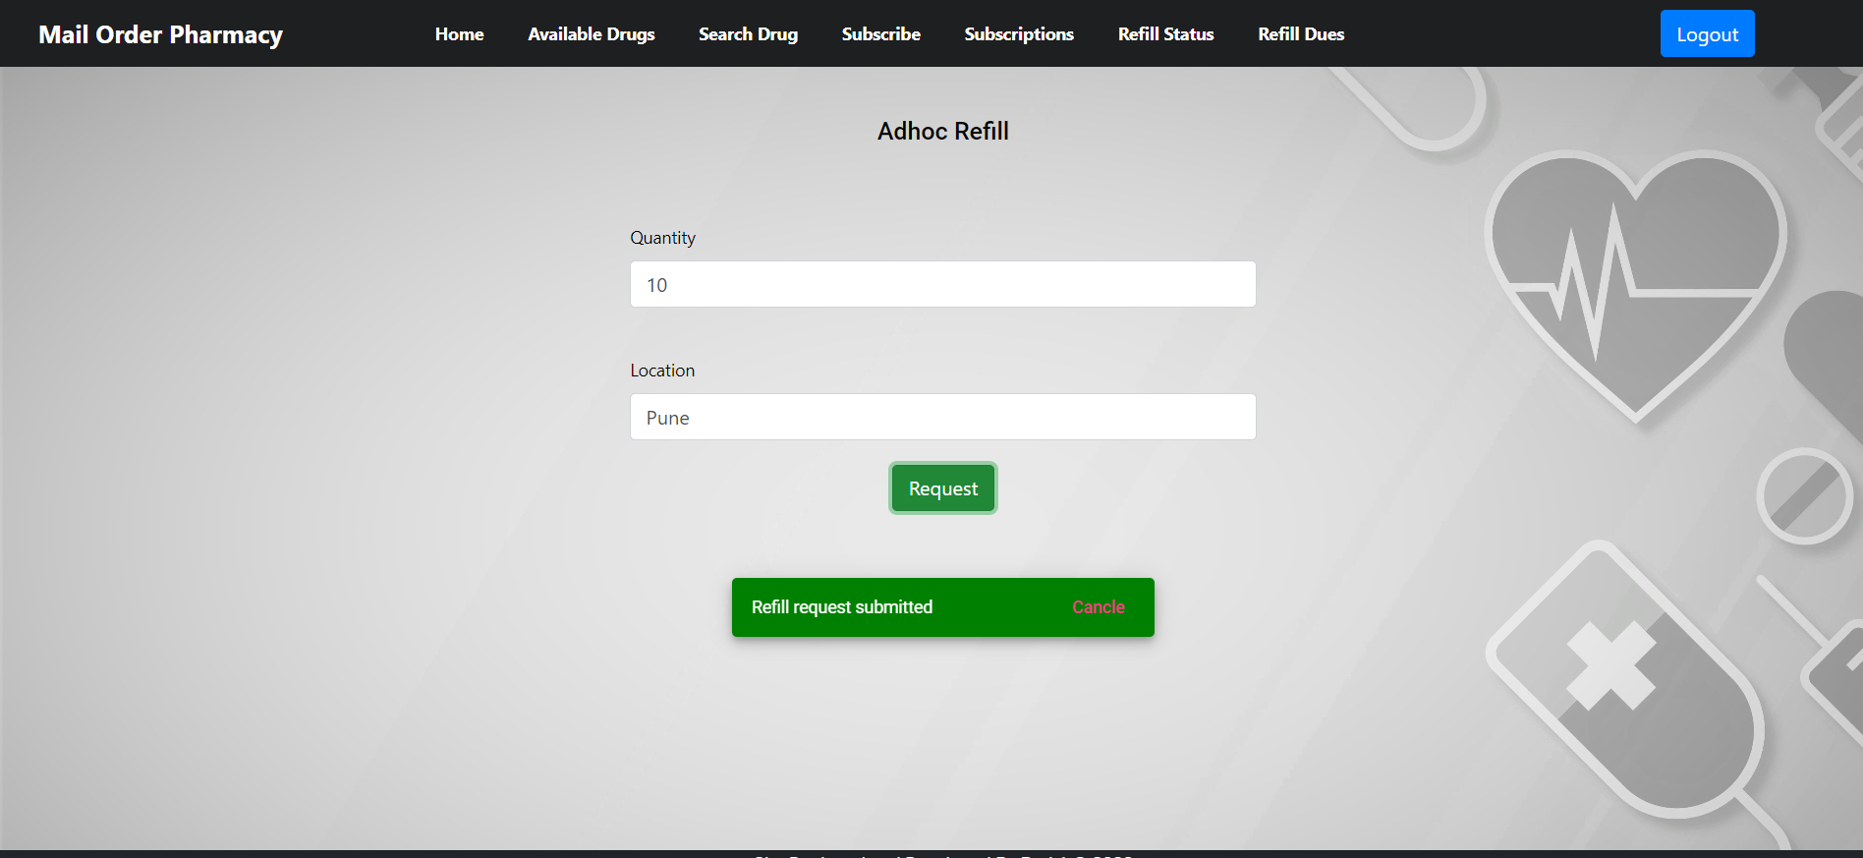
Adhoc refill - UI

Slide 17
Conclusion
From this MFPE we have learnt about Spring Web MVC, Angular, Rest API, Spring Web Security.
We also got to know about Microservice and its use and how it communicates using feign client.
We also learnt H2 Database and how exactly the frontend and backend are connected internally.
All through the journey of MFPE we got to know how teamwork plays an important role in making the project a success.

Slide 18


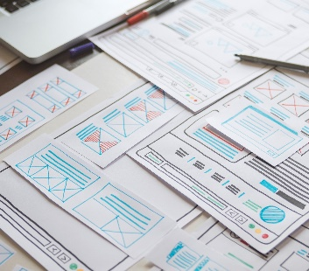

Thank You

